Slide 1
Sanskritization: An Introduction
M N Srinivas wrote: “Sanskritization is the process by which lower castes, tribes, or other groups change their customs, rituals, ideology, and way of life towards those of higher castes“. Examples include wearing sacred threads, refusing to use meat and alcohol, observing endogamy, and forbidding widows from remarrying.
In his study of Coorg of Mysore, M.N. Srinivas found that the lower castes sought to rise in the caste hierarchy by adopting some Brahmin cultural ideals. As a result, they left behind some of the ideals considered impure by the Brahmins. To describe this movement process, Srinivas used the term “Brahminization”. He later called it “Sanskritization” in the broader sense.
The term refers to a ‘Process by which low Hindu caste or tribe or other group, changes its customs, rituals, ideologies and ways of life in the direction of a high twice born caste to acquire higher status’. At first Prof. Srinivas used the term ‘Brahminisation’ for this process as he thought that the lower caste people must be trying to reach at the place of Brahmins. But later on he found that not only they are following Brahmins but also other caste groups. So, he replaced Brahminisation by Sanskritisation.

Slide 2
In some societies, people of lower castes followed not only Brahmin customs but also those of the locally dominant caste, such as the Kshatriya and Vaishya raising their status. Srinivas pointed out that in caste structures with fixed and genetic placements/ranks, Sanskritization became a process that enabled movement in caste positions/roles of particular castes.
The process of Sanskritization is not limited to castes in Hindu society, but can also be found in tribal societies. It is therefore a lingering phenomenon that is not only confined to caste hierarchies/religious structures but also encompasses broader social and cultural processes that are integrated and not confined to the Hindu caste system.
Sanskritization involves both cultural accumulation and cultural decline. The “lower” caste abandons rituals, customs, traditions, and values. Therefore, there is cultural poverty. On the other hand, there is also an accumulation of culture that incorporates new values, traditions, and customs of the upper castes.
The concept of Sanskritization also led to non-Sanskritization. In modern times, some of the upper castes may mimic the behavioral patterns of the “lower” castes, for example, Brahmins began eating meat and alcohol. This process is called de-Sanskritization.

Slide 3
Major Issues related to Sanskritization:
The mere fact that it takes caste decades to raise its status indicates the slowness of the process, and slowness is the opposite sign. The concept of Sanskritisation is very closely related with ‘dominant caste’. It helps in the process of cultural transmission.
The most important factor impeding this process is the antipathy of other castes to the caste that seeks to elevate itself. Political and economic pressures often come. Sometimes even physical violence is used to prevent the lower castes from adopting the customs and rituals of the upper castes.
On the other hand, the lower castes adopt the traditional values ​​and customs of the upper castes and try to elevate their status and the upper castes have abandoned some of these practices. Increased industrialization, expanded communication, new occupations, and expanded education are likely to make westernization a more dominant process.
Another factor that hinders the process of Sanskritization is Westernization. Westernization can be characterized as a transition from the sacred to the mundane.
Both Sanskritization and Westernization processes occur simultaneously, creating a contradictory or even confusing situation. Most castes face the dilemma of making a choice.

Slide 4
Effects of Sanskritization on society:
Sanskritization has an influential effect on society in many ways.
More Equality and Liberty: Some scheduled castes adopted upper-caste names, discovered myths about their origin and changed their traditional occupations. Now they sit along with the higher caste on the cots without any fear or hesitation.
Behavioural change: Lower caste adopted other castes living patterns which gave them the liberty to sit and stand before other castes. For example, lower caste people were not keen to keep a clean atmosphere but due to Sanskritization, they started maintaining hygiene. They have left prohibited food. They also keep their houses clean and put on dresses like higher castes.
Value Transmission: It helped in socio-economic and cultural value transmission in several groups of society.
Exposure to New ideas: Sanskritisation is not just the adoption of new customs and habits, but also includes exposure to new ideas and values appearing in Sanskrit literature. Some of the most common Sanskritic theological ideas like Karma, dharma, Paap, Maya, Samsara and Moksha, which become common in the talk of people who are Sanskritised.

Slide 5
Redefined Caste System: Sanskritisation challenged the then prevalent idea that caste was a rigid and unchanging institution. The concept of Sanskritisation addressed the actual complexity and fluidity of caste relations. It brought into academic focus the dynamics of the renegotiation of status by various castes and communities in India.
Societal Up-gradation of lower caste: The low caste individuals are inclined towards Sanskritization because in that way they can elevate their social status and get higher status in the caste hierarchy.
Reduced Untouchability: Now the situation is that the untouchable practice is almost abolished from society.
Professional Changes: The lower caste people have given up un-cleaned occupation to raise their economic status because clean trades are a symbol of social light.
Many scheduled castes and tribes changed their dressing style and eating habits in a similar way of upper castes. But they had to face a lot of violence by upper castes for following their way of life. Though the process is followed by many, only those that are politically or economically powerful succeeded in the process.

Slide 6
Sanskritization has prompted the untouchable castes to give up the consumption of liquor, beef, domestic pork or toddy. On this basis Srinivas predicts that “in the next twenty or thirty years the culture of untouchables all over the country will have undergone profound changes.”
Sanskritization appears to be more closely related to religious system but the chief aim of Sanskritization is social. The low caste individuals are inclined towards Sanskritization because that way they can elevate their social status and get higher up and caste-hierarchy. They want a place equal to that of Brahmans and Kshatriyas

Slide 7
Westernization
Westernization is a process whereby societies come under or adopt Western culture in areas such as industry, technology, law, politics, economics, lifestyle, diet, clothing, language, alphabet, religion, philosophy, and values. Westernization has been an accelerating influence across the world in the last few centuries,
The concept was also constructed by M.N. Srinivas to describe the process of social and cultural mobility in the traditional social structure of India. It has also emerged, in Srinivas’ study of the Coorgs of south India. The author has defined westernisation as “the change brought about in Indian society and culture as a result of over 150 years of British rule

Slide 8
Impact of Westernization on Indian Society
Growth of a Universalistic Legal System:
The process of westernization brought in its wake new legal norms which contributed to the growth of a universalistic positive form of law in India.
Impact of Westernization on Education:
Contemporary education is of western origin. Traditionally, the content of education was metaphysical. It was confined to the upper classes or the twice born castes. Its structure was hereditary and closed. But Modern education has a fundamentally different orientation and organization. Its content is liberal and it preaches scientific world-view. Freedom equality, humanism and denial of faith in dogmatism are the major themes of modern education
Impact on the Communication network:
The media of communication have been introduced in India through the western contact. Printed newspapers came into existence only after India’s contact with the West. The Britishers introduced the telegraph, railways and modern postal system in India. Similar improvement has also been made in the other media of communication and transport

Slide 9
Growth of Nationalism:
Both Nationalism and democracy in the contemporary form are the gifts of westernization. Nationalism implies consciousness of one’s nationhood. Its sociological manifestation is the idea of nation-state. Democracy is a special form of political organization and system of values on which nation-state can be founded
Impact on Food habits and Mode of eating:
Westernization has reached the level of food habits and way of eating. Traditionally, Indians ate their meals sitting on the floor. Food was served either on the leaves or onbrass, bronze or silver plates. Among the upper castes, and especially among Brahmin, eating was a religious act.
Impact on the Dress Pattern:
Under the influence of westernization even people living in villages have opted for factory-made clothes like nylon, Terylene, terycot etc. in place of home-spun clothes, readymade garments have become popular. The mode of dress has also under gone a drastic change. The old style of shirt has been replaced by the modern style shirts.

Slide 10
Change in Language:
Many terms from the English language have entered the dialects of the rural folk. The expansion of civil administration popularized the terms like court, collector, judge, barristers etc. similarly the expansion of transport facilities has rendered the terms like rail, station, signals etc. matters in daily usage.
Weakening of Traditional Culture:
Modern education and increased utilitarian and rational values of the Indian elite led them to make sharp criticisms of their own culture. They began casting aspersion on the evils of our traditional culture which used to make submissive.
Impact on Marriage:
Westernization has also brought about noticeable changes in matrimonial relationship. Marriage today is no longer seen as a relationship between two families rather it has transformed to the relationship of two individuals i.e. husband and wife.

Slide 11
Impact on Family:
Western culture preaches the individualistic ideology of family which is diametrically opposite to the collective ethos on which the joint family system is founded, imbibing the individualistic philosophy people give importance to the individual over the group there by they encourage self-men.
Impact on the Status of Women:
A strong influence of the west is tangible on the status of women today. The medieval period in Indian history is witness to the status of women sinking to the nadir and if we find today women getting their due in almost all the fields, a major part of the credit goes to westernization.
Impact on Customs:
Indian masses which were a bit reluctant initially in accepting the ways of the west are now jumping to their ways. From clothes to houses we live in, all bear the stamp of western style and it has become a status symbol. Cosmetic, decoration of pieces, crockery and even the methods of greetings have all become westernized.
Eradication of Social Evils:
Social evils which had plagued the society and in a way were responsible for making Indian society so much vulnerable to foreign annexation, could only be given a determined fight after the process of westernization took its root. No doubt, a few social workers had raised their fingers against these social evils before but it was the process of westernization which prepared a broad base through which efforts against these evils could bear fruit

Slide 12
“Modernization” is understood as a process which indicates the adoption of the modern ways of life and values”. The term was being used previously to refer only “to change in economy and its related effect on social values and practices”.
It was also described as a process that changed society, from primarily agricultural to a primarily industrial economy.
Modernization’ is understood as an attempt, on the part of the people, particularly those who are custom-bound, to adapt themselves to the present time, conditions, styles, and ways in general. It indicates a change in people’s food habits, dress habits, speaking styles, tastes, choices, preferences, ideas, values, recreational facilities and so on. It is also described as “social change involving the elements of science and technology”.

Slide 13
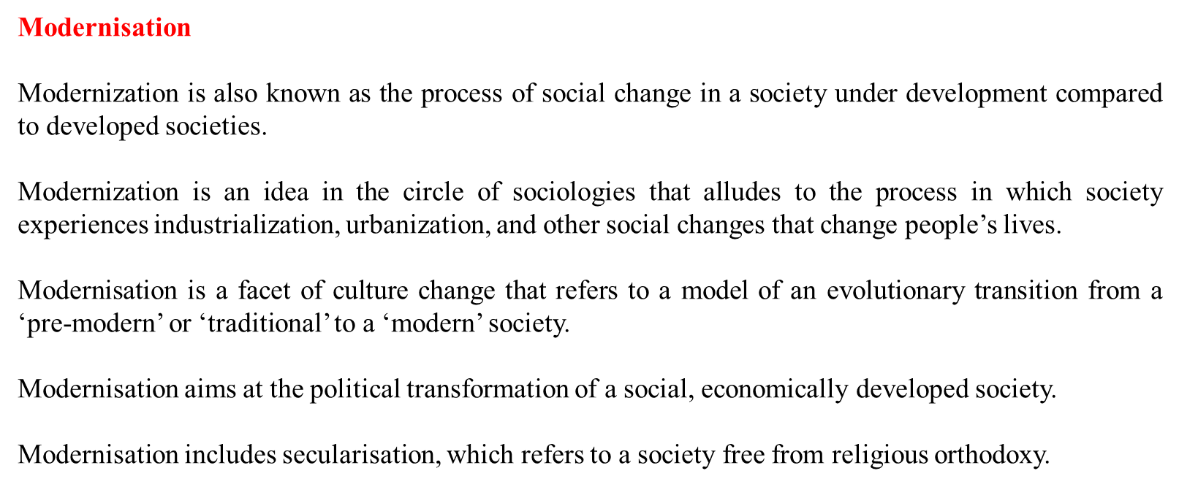

Slide 14
DEFINITION
According to Daniel Lerner “Modernization is the current term for an old process of social change whereby less developed societies acquire the characteristics common to more developed societies”.
Smelser. Modernization refers to “a complex set of changes that take place almost in every part of society as it attempts to be industrialized. Modernization involves ongoing change in a society’s economy, politics, education, traditions, and religion”.
S.H. Alatas. “Modernization is a process by which modern scientific knowledge is introduced in the society with the ultimate purpose of achieving a better and a more satisfactory life in the broadest sense of the term as accepted by the society concerned”.
Rutow and Ward (1964) the basic process in Modernization is the application of modern science to human affairs.
Eisenstadt Modernization refers to both (a) structural aspects of social organization, and (b) socio-demographic aspects of societies.
Prof. Yogendra Singh says, “Modernization symbolizes a rational attitude towards issues and their evaluation but not from particularistic point of view”.

Slide 15
FEATURES/CHARACTERISTICS OF MODERNIZATION
Application of technology and mechanization
Industrialization.
Urbanization
Rise in national and per-capital Income.
Increase in literacy.
Political participation.
Development of mass-media techniques.
Social mobility

Slide 16
Due to modernization, so many changes are found in India:
Introduction of new institutions like banking, mass media communication etc.
Introduction of new value systems such as equality, justice, individualism, secularism etc.
Acceptance of scientific innovation.
Increase in the standard of living.
Introduction of large scale industries.
Restructuring of the political system, i.e., the introduction of democracy.
Introduction of structural changes in social institutions like marriage, family, caste etc.
The emergence of the middle class.
There are some eliminative changes like the disappearance of cultural traits, behaviour pattern, values etc. For example, the abolition of feudal power.
There is a shifting of attitude from sacred to secular.
Emergence of new forms because of the synthesis of old and new elements. For example, nuclear family in structure but functioning as joint.
Adoption of new cultural traits such as a new election system.

Slide 17
Modernisation | Westernisation
Modernisation means to free oneself from traditional norms and value systems that have become obstacles | Westernisation initiates the western cultures, norms and styles in non-western countries
Moulding oneself to become a better person with a broad mind, free-thinking, and innovative mindset | Moulding oneself into a westernised framework by not focusing on one’s inherited values
Adoption of modernisation helps in building a better society for living | Its adoption is equivalent to learning one’s foundation
Modernisation increases the use of science, it changes the thinking mode and causes a revolution | Westernisation is responsible for diminishing joint families, and marriage breaks
Modernisation involves changes not only at the institutional level but also on fundamental level changes in personal life | Westernisation is a process of following instructional and fundamental changes of western countries by the other non-western countries
Modernisation means the development of any country through economic growth, technology development and infrastructure raise | Westernisation means adopting the technology and infrastructure of western countries

Slide 18
Industrialization is the process by which a society becomes technologically advanced, especially in terms of manufacturing and production. Here in this article, we have explained what is industrialization and its history, meaning definition, and advantages.
Industrialization means the development of industries (manufacturing, production) and transformation into a tertiary sector from the primary sector of the economy.
The industrialization has a major role to play in the economic development of underdeveloped countries.
Industrialization is the period of Social and economic change that transforms a human group from an agrarian society into an industrial one.
The industrialization has been defined as the process of social and economic change that transforms a human group from an agrarian (farming) society into an industrial one.
“The process whereby a society moves from a predominantly agricultural activity to one where the economy is dominated by manufacturing. Industrialization is associated with dislocation as society adapts to the massive social changes that industrialization creates.” – T. Lawson and J. Garrod (1996, The Complete A-Z of Sociology)

Slide 19
INDUSTRIALISATION

Slide 20
Industrialization is the process of Social and economic changes whereby a society is transformed from a pre-industrial society into an industrial one. Industrialisation connotes a shift from an agrarian economy leading to the rise of manufacturing industries. It was industrial revolution in England and some other European countries which laid down the foundation of Industrialisation.
According to Ms Gore, “industrialization refers to a process where in production of goods with the use of hand tools are replaced by the production with the use of power driven machines”. This brings corresponding changes in the technologies of agriculture, transport and communication and also changes in the organization of trade and finance.
According to the concise Oxford Dictionary of Sociology, the term industrialism and industrialization denote a transition in the methods of production which creates vast increase in the wealth creating capacity of modern societies as compared to traditional systems.
Industrialization is a historical process of social and economic change whereby a country's economy comes to be based primarily on the manufacturing of goods

Slide 21
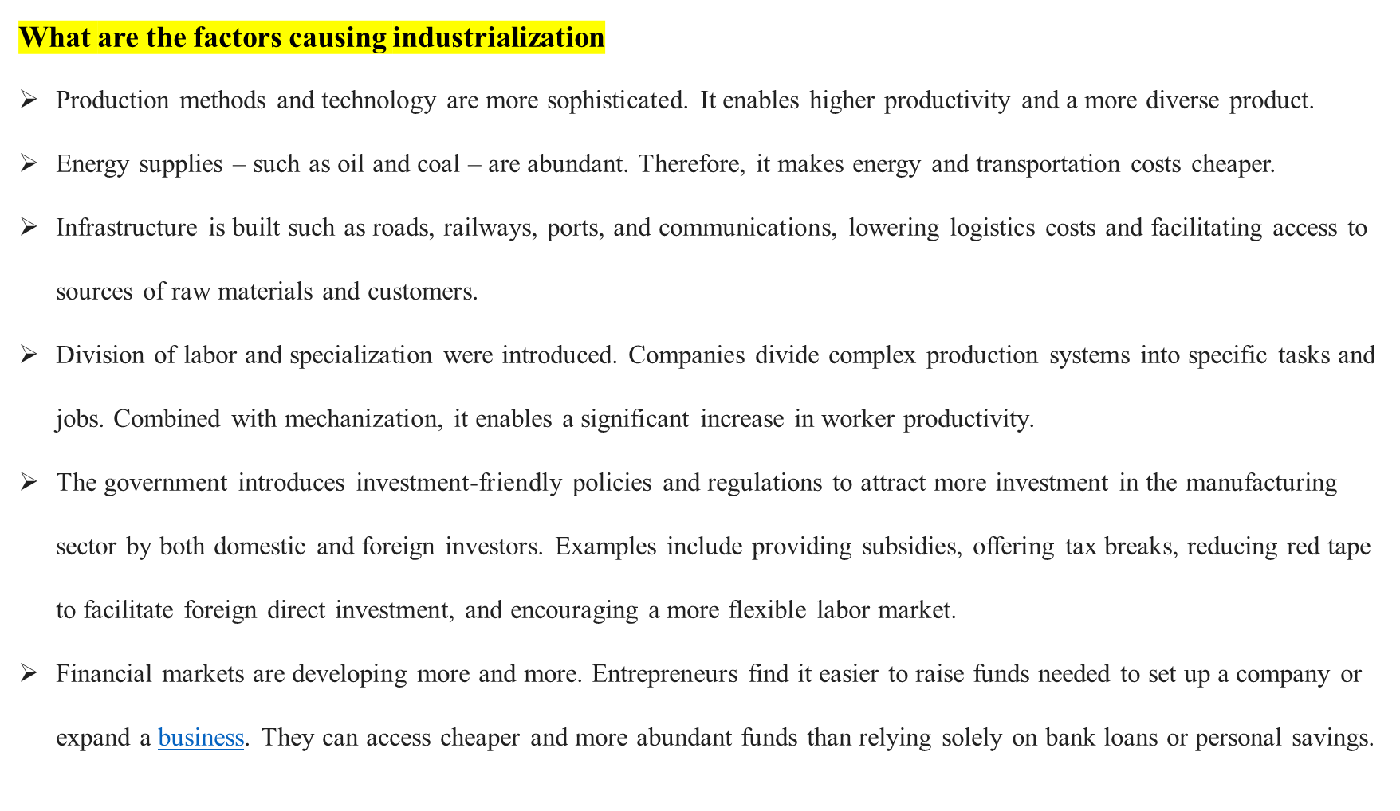

Slide 22
CHARACTERISTICS OF INDUSTRIALISATION
•It involves Large Scale mechanisation and automation.
•It lays the foundation of Factory System under which an entrepreneur employs hired
labour in the production system.
•It involves the application of scientific methods in industry for the purpose of
improving productivity and quality.
•It leads to division of labour and specialisation.
•It increase the geographical and social mobility of labours
•It involves better utilisation of idle natural resources for speedy economic
development.
•It attracts labour from agriculture and allied occupations to industry

Slide 23
CAUSES OF INDUSTRIALISATION
The main factors which gave stimulus to industrialisation are as follows:
•Large Scale Production:.
•Mechanisation:
Automation:
Management Information System:
•Specialisation:.
•Standardisation:
Growth of Industrial Areas:
•Expansion of International Trade:
Research and Development
Competition

Slide 24
CONSEQUENCES OF INDUSTRIALISATION
Impact of Industrialization on Marriage
Impact of Industrialization on Family
Impact of Industrialization on Caste System
Impact of Industrialization on Social stratification
Impact of Industrialization on Religion
Impact of Industrialization on Morals
Impact of Industrialization on Entertainment

Slide 25
IMPACT OF INDUSTRIALIZATION ON MARRIAGE
Marriage as a Social Contract:
Higher Age of Marriage
. Practice of Non Marrying
Practice of Love Marriage:
Increase in Divorce Rate
IMPACT OF INDUSTRIALIZATION ON FAMILY
Role of Family
Breaking up of Joint Family
Nucleus Family
Status of Women
Disintegration of Family
Change in Family Goals

Slide 26
IMPACT OF INDUSTRIALIZATION ON CASTE SYSTEM
Disintegration of Caste System
Abolition of System of Caste based Function
Division of Labour based on Specialisation
Loosening Hold of Untouchability
Solemnisation of Inter caste marriage
IMPACT OF INDUSTRIALIZATION ON RELIGION
Decline of superstitions
Development of religious tolerance
Secular States
IMPACT OF INDUSTRIALIZATION ON MORALS
Rational outlook:
Materialistic outlook:
Individualism:
Increase in rate of crime
Loosing of social control

Slide 27
.

Slide 28
What is urbanization? definition and meaning
Urbanization refers to the process of increase in the number of people living in urban areas and the ways in which the population adapts to the change. Urbanization increases with industrialization. As urbanization increases, a number of towns and cities increases, and people begin to live and work in central areas. Urbanization is a result of the historic transformation of human societies, where the rural culture is being replaced by urban culture. The rural culture consists of closeness in relations and communal behavior amongst the members of society. However, the urban culture consists of distant relations and there is competition amongst each other. The lifestyle of cities is very beneficial in terms of cultural and economic factors.
Broadly, urbanization refers to the growth of towns and cities as people move from rural areas to urban centres with a hope to lead a better life.

Slide 29
Urbanization implies a cultural and social psychological process whereby people acquire the material and non-material culture, including behavioural patterns, forms of organization, and ideas that originated in, or are distinctive of the city.
Urbanization as an Economic Process
Urbanization in modern times is essentially an economic process. Today, the city is a focal point of productive activities. It exists and grows on the strength of the economic activities existing within itself. It is the level and nature of economic activity in the city that generates growth and, therefore, further urbanization.
Urbanization as a Geographical Process
a) the migration of people from rural villages to towns and cities leading to macro-urbanization b) the migration of people from smaller towns and cities to larger cities and 121 capitals leading to metropolisation.

Slide 30
Causes of Urbanization
Industrialization:
Commercialization
Social benefits
Employment opportunities
Modernization and changed lifestyle:
Rural-urban transformation:
Effects of Urbanisation Positive Effects
Better living standards
Better market potential
Better services
Negative Effects:

Slide 31
Negative Effects:
Housing problems
Overcrowding
Unemployment
Development of slums
Water scarcity
Sanitation problems
Poor health
Traffic-congestion
Trash disposal
Rising crimes

